Slide 1

STUDENT REPORT MANAGEMENT SYSTEM
Made By: Anish Benjwal CO20307
Lalit Kumar CO20328
Vyom Verma CO20368

Slide 2
INTRODUCTION
Student Report Management System (SRMS) is a faster and more efficient way of storing marks of students in an ordered manner.
It will nullify the need of big registers which is usually used to write down marks.
Since there is no need of registers, it will be beneficial for environment too.
Marks of whole class of all subjects can be viewed in an ordered table.
Marks of a specific subjects can be viewed too.
Making modifications in marks is very easy too.

Slide 3
KEY FEATURES
Adding new standard
Adding subjects in the standard, and assigning teachers.
View existing standards, teachers list.
Add students and input marks in any specific subject.
View marks of any specific subject of any standard.
View marks of all students in a standard.
Percentage is automatically calculated for a student.

Slide 4
ADMIN FUNCTIONS
Create new Teachers
Admin can create new standards and assign it’s class in charge.
Assign teachers to subjects of the standards.
View all standard details (excluding marks of students).
View all teachers details (excluding password)
Reset it’s own password.
Note:
Default password for admin is “admin” and username is fixed to be “admin”.

Slide 5
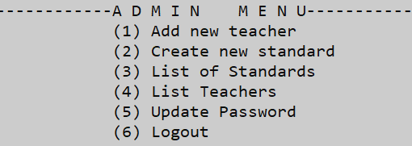
ADMIN MENU

Slide 6
TEACHERS
Teachers can add new students to their class, i.e. in which they are class in- charge.
Input marks of students already added.
Teachers can add and view marks of only those subjects of standards which they have been assigned by the admin.
View all the details and marks of their class, i.e. in which they are class in- charge.
View their account details.
Update password of their account.
Note:
Default username and password of the teacher will be set by admin. Teachers can update their password if they wish to do so.

Slide 7
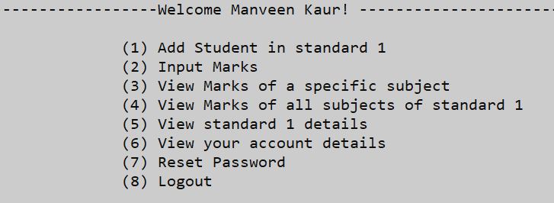
TEACHER MENU for a class incharge.

Slide 8
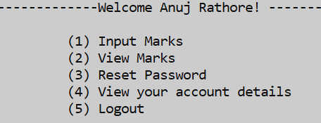
TEACHER MENU for not a class incharge.

Slide 9
Possible future improvements
Modify username of both admin and teachers according to their liking.
Modify subject name, standard name.
Add subject at a later time in already existing standard.
It can be made in GUI which will be much more user friendly.
It can be stretched to student report system, where student can login and view their reports too.

Slide 10
REFERENCES
Object Oriented Programming in C++ by E.Balaguruswamy
en.cppreference.com
www.geekforgeeks.com
www.google.com

Slide 11
THANK YOU

